Slide 1
A PROJECT ON
PREDICTING THE SALARIES OF PROFESSORS

Slide 2


In partial fulfilment of the requirements for the award of
MASTER OF SCIENCE IN STATISTICS
DEPARTMENT OF STATISTICS
UNIVERSITY COLLEGE OF SCIENCE
OSMANIA UNIVERSITY HYDERABAD – INDIA
Done By
M.PRATHIMA Roll No:1007-17-507-041
S.SHRAVANI Roll No:1007-17-507-017
M.LIKITHA Roll No:1007-17-507-034
P.MADHURI Roll No:1007-17-507-016
P.LAVANYA Roll No:1007-17-507-042
B.MADHAN MOHAN Roll No:1007-17-507-033
R.DIVYA Roll No:1007-17-507-025

Slide 3

Machine learning
Artificial Intelligence(AI): Creating the intelligence system which behave like human brain.
Machine learning : Machine learning is the learning of the input without giving the code explicitly and getting output
Machine learning can be also said as
R L O
Representation of data Learning of data Optimization

Slide 4
Overview of datamining/Modelling process
KDD - Knowledge Discovery in database
CRISP-DM - Cross Industry Standard Process for Datamining
SEMMA - Sample Explore Modify Model and Assess

Slide 5
CRISP-DM (Cross Industry Standard Process for Data Mining )
CRISP-DM is an open standard process model that describes common approaches used by data mining expert .
It is the most widely used analytics model.
There is a cyclic nature of data mining.
Data mining process continues after solution has been deployed.

Slide 6
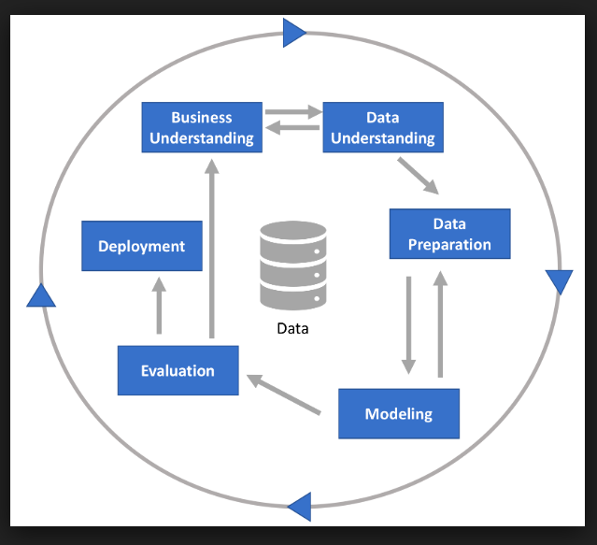
PHASES IN CRISP-DM

Slide 7
BUSINESS UNDERSTANDING

Slide 8
Scope of the problem:
This problem is related to the financial and academic decision area.
One of the leading university in united states desired to ascertain
What are parameters to evaluate salaries .
What are the characteristics taken to evaluate the academic 9 month salaries for professors(Assistant professors(3), Associate professors(2), professors(1)).
An algorithm ,by which we can predict a new respondent’s salary.

Slide 9
Source: https://vincentarelbundock.github.io/Rdatasets/doc/carData/Salaries.html
Description:
Salaries for Professors
The 2008-09 nine-month academic salary for Assistant Professors , Associate Professors and Professors in a college in the US. The data were collected as the part of the on-going effort of the college’s administration to monitor salary.
Usage:
Salaries
Format:
A data frame with 200 observations on the following 6 variables.
Rank
a factor with levels Prof(1), AssocProf(2), AsstProf(3) .

Slide 10
Discipline
a factor with levels A(“Theoretical departments”) or B(“Applied department”).
Yrs.since.phd
years since PhD.
Yrs.service
years of service.
Sex
a factor with levels female(1) and male(0).
Salary
nine-month salary , in dollars.

Slide 11
DATA UNDERSTANDING

Slide 12
COLLECTION OF DATA

Slide 18
DATA PREPARATION

Slide 30
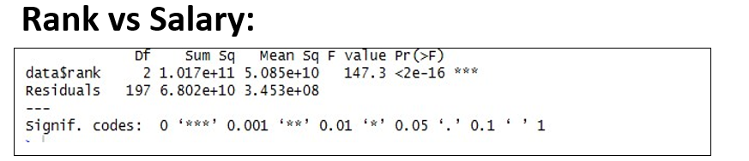
CHECKING FOR THE SIGNIFICANCE DIFFERENCE BETWEEN THE VARIABLES
To test the significance difference between continuous and categorical variables, we look at the ANOVA.
From the above table p-value<0.001,we conclude that there is significant difference between salary and rank

Slide 31
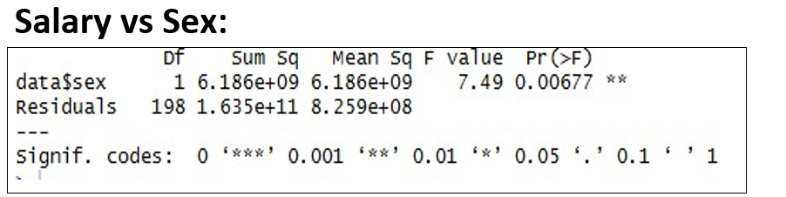
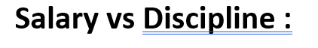
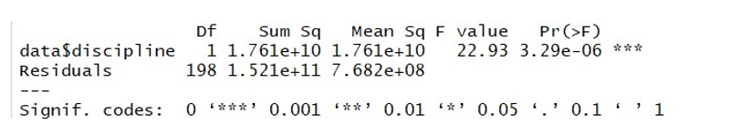
x2=aov(data$salary ~ data$sex)
Summary(x2)
From the above table as pvalue <0.01 ,we conclude that there is the significant difference between salary and sex.
X3=aov(data$salary ~ data$discipline)
summary(x3)
From the table as p<0.001 ,we conclude that there is no significant difference between salary and discipline.

Slide 32
MODELLING

Slide 37
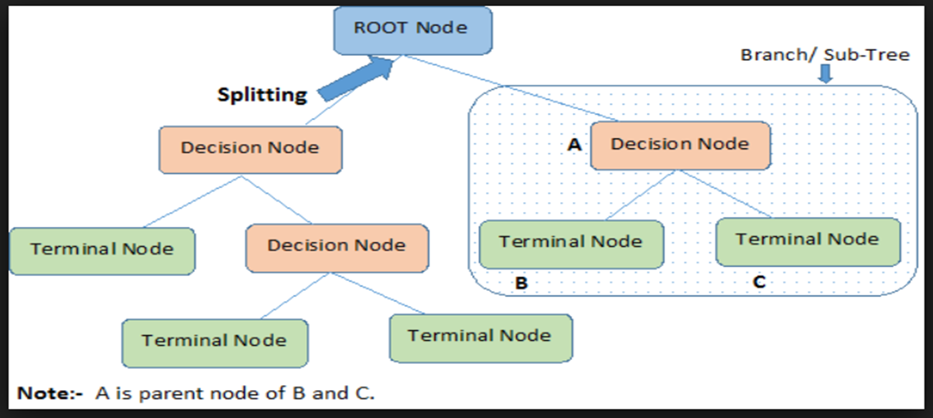

Slide 38
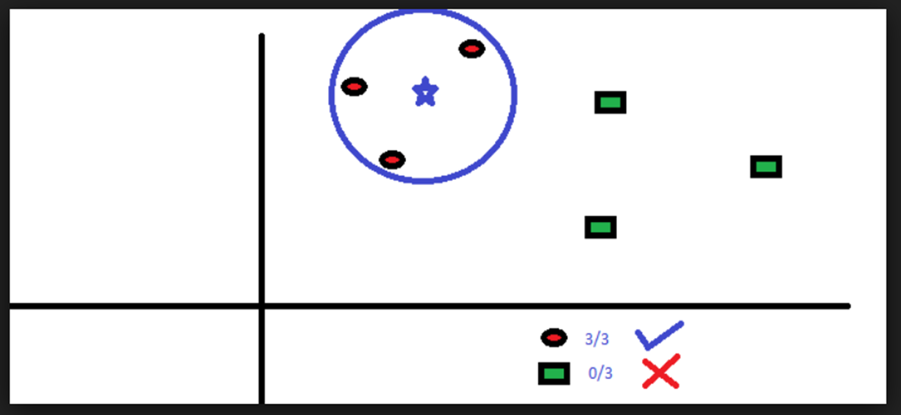

Slide 39
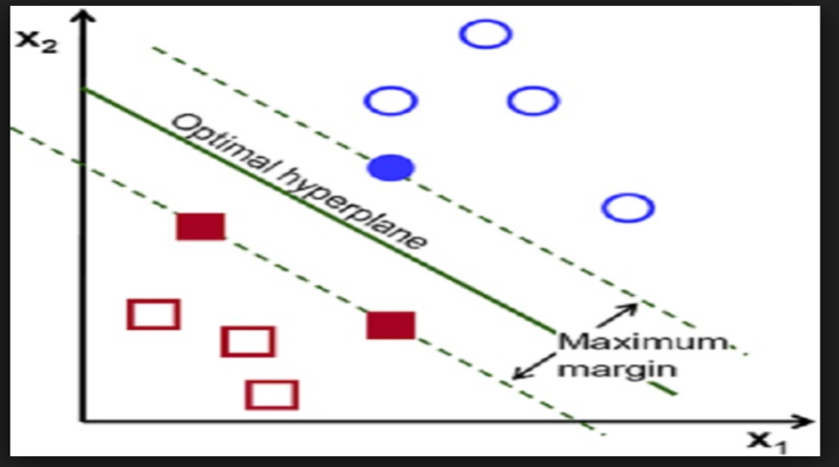

Slide 40
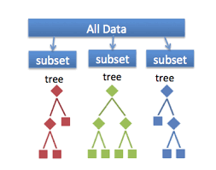

Slide 44
VALIDATION

Slide 46
CONCLUSION
Since the accuracy of train and test data are more or less similar , we conclude the the model is generalised model .
So this obtained generalised model can be applied for any un seen data for future analysis

Slide 47

THANK YOU!!

